Slide 1
Visualize Your Data with Power BI
- Tanmay Damle

Slide 2
Table of contents
01
02
03
04
Introduction
Setup
The What, Why and How of Power BI ?
Download, Install and Get Ready
Demo
Into the Dataverse
Report Building from scratch
Learn more about Power BI and data analysis

Slide 3
01
Introduction
The What, Why and How of Power BI ?

Slide 4
— Ronald Coase
Some Cool Quote from the Internet to grab your attention
“If You Torture the data long enough
it will confess to anything”

Slide 5
Power BI
Written in Typescript/ JavaScript, C#, .NET framework
Power BI is a collection of software services, apps, and connectors that work together to turn your unrelated sources of data into coherent, visually immersive, and interactive insights
Uses DAX (DML) and M (DQL, DTL)
Easy to learn
Can Use multiple data sources like SQL Servers, CSV, Web, Excel, NoSQL, Graph Databases
Supports Python and R Scripts

Slide 6
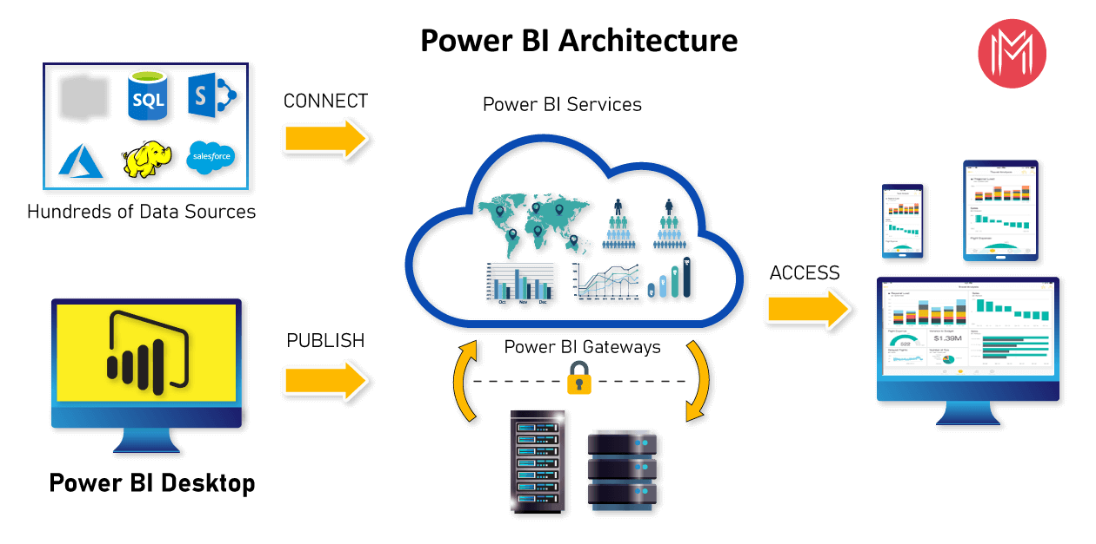

Slide 7
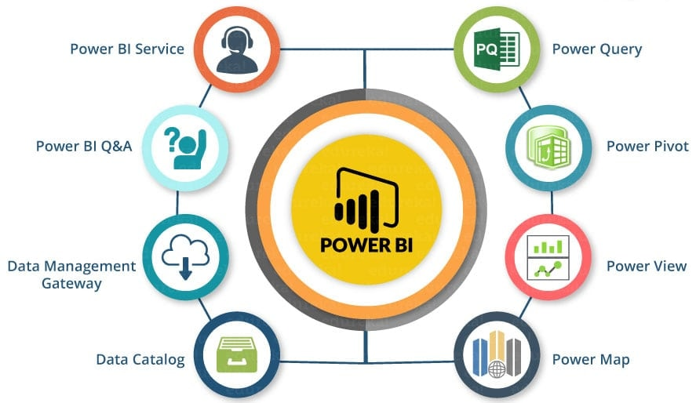
Power BI Madness

Slide 8
02
Setup
Download, Install and Get Ready

Slide 9
98,300,000
Big numbers catch your audience’s attention, did this catch yours ?

Slide 10
Most commonly used charts
Line chart
Column chart
Pie chart

Slide 11
Other chart types
Donut chart
Area chart
Pyramid chart
Bar chart

Slide 12
Classification of statistical data
Statistical data
Quantitative
Qualitative
Continuous
Discrete
Ordinals
Nominals

Slide 13

A picture is worth a thousand words (or so they say)

Slide 14

Demo
03
Report Building from scratch

Slide 15
Process of Building A Report
Build Relations
Study the Data
Import the Data
Make the Report

Slide 16
04
Into the Dataverse
Learn more about Power BI and data analysis

Slide 17
Resources to Learn More
Dataset - https://docs.yugabyte.com/preview/sample-data/retail-analytics/
https://www.youtube.com/@GuyInACube
https://www.youtube.com/@SQLBI
https://www.youtube.com/watch?v=waG_JhBgUpM - DAX
https://www.youtube.com/watch?v=yTOSOgUGKe4 - DAX
https://www.youtube.com/watch?v=UXhGRVTndQA - Courses
https://www.youtube.com/watch?v=g0m5sEHPU-s&list=PLUaB-1hjhk8HqnmK0gQhfmIdCbxwoAoys - Course Playlist Beginner Level
https://www.youtube.com/watch?v=3u7MQz1EyPY - Course
https://learn.microsoft.com/en-us/power-bi/ - Official Docs

Slide 18

Shameless Self Promotion
https://github.com/damletanmay
damlet@uwindsor.ca

Slide 19
Thanks!
Do you have any questions?
damlet@uwindsor.ca
Or Say Hi to Tanmay Damle On Teams

